Slide 1
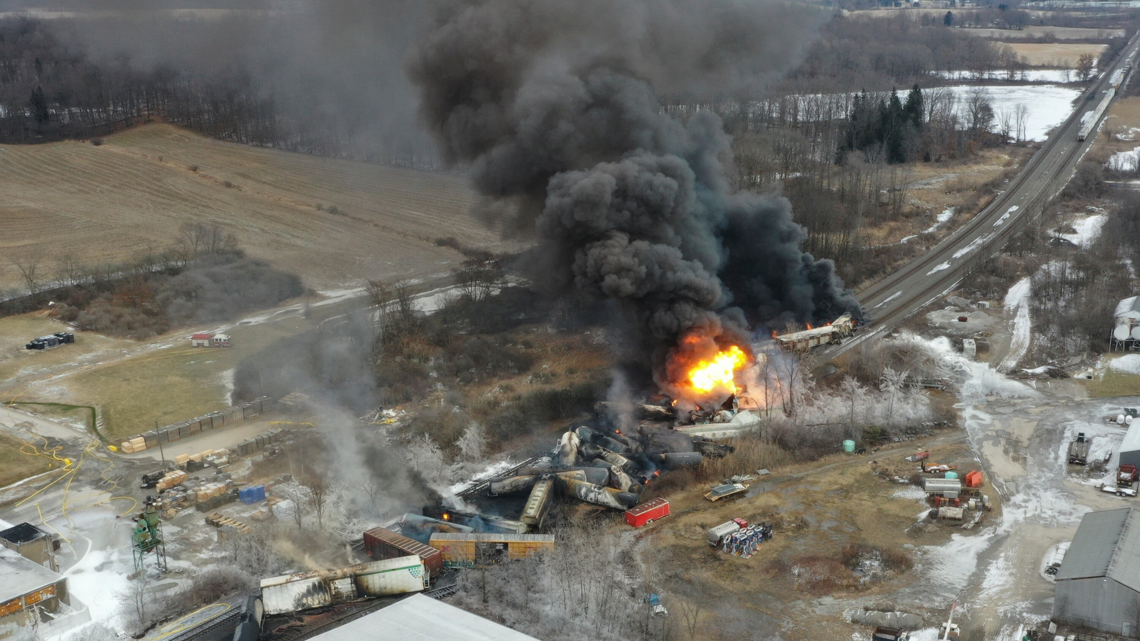

The Effectiveness of Social Media in Timely Disaster Communication
Chongdan Pan, Hang Chen, Chia-Hsun Chang, Yun Lee
University of Michigan – School of Information
Notes:
Hello everyone, this is Yun from UMSI. My team Congdan, Hang , Chia-Hsun and I are going to present our final project for SI 699 capstone project.
Our study focuses on the effectiveness of social media in timely disaster communication.

Slide 2
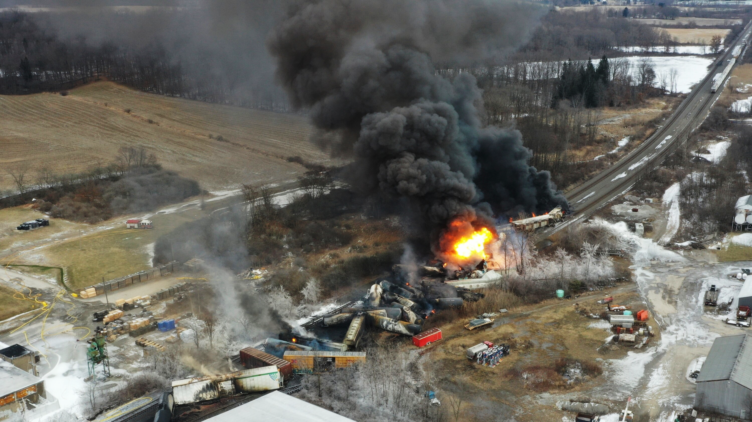
The Ohio Train Derailment
February 3rd, 2023
Notes:
To provide context, our study was motivated by a recent incident that happened in Ohio on February 3rd where a derailment caused a huge explosion, releasing over a hundred thousand gallons of hazardous materials.

Slide 3
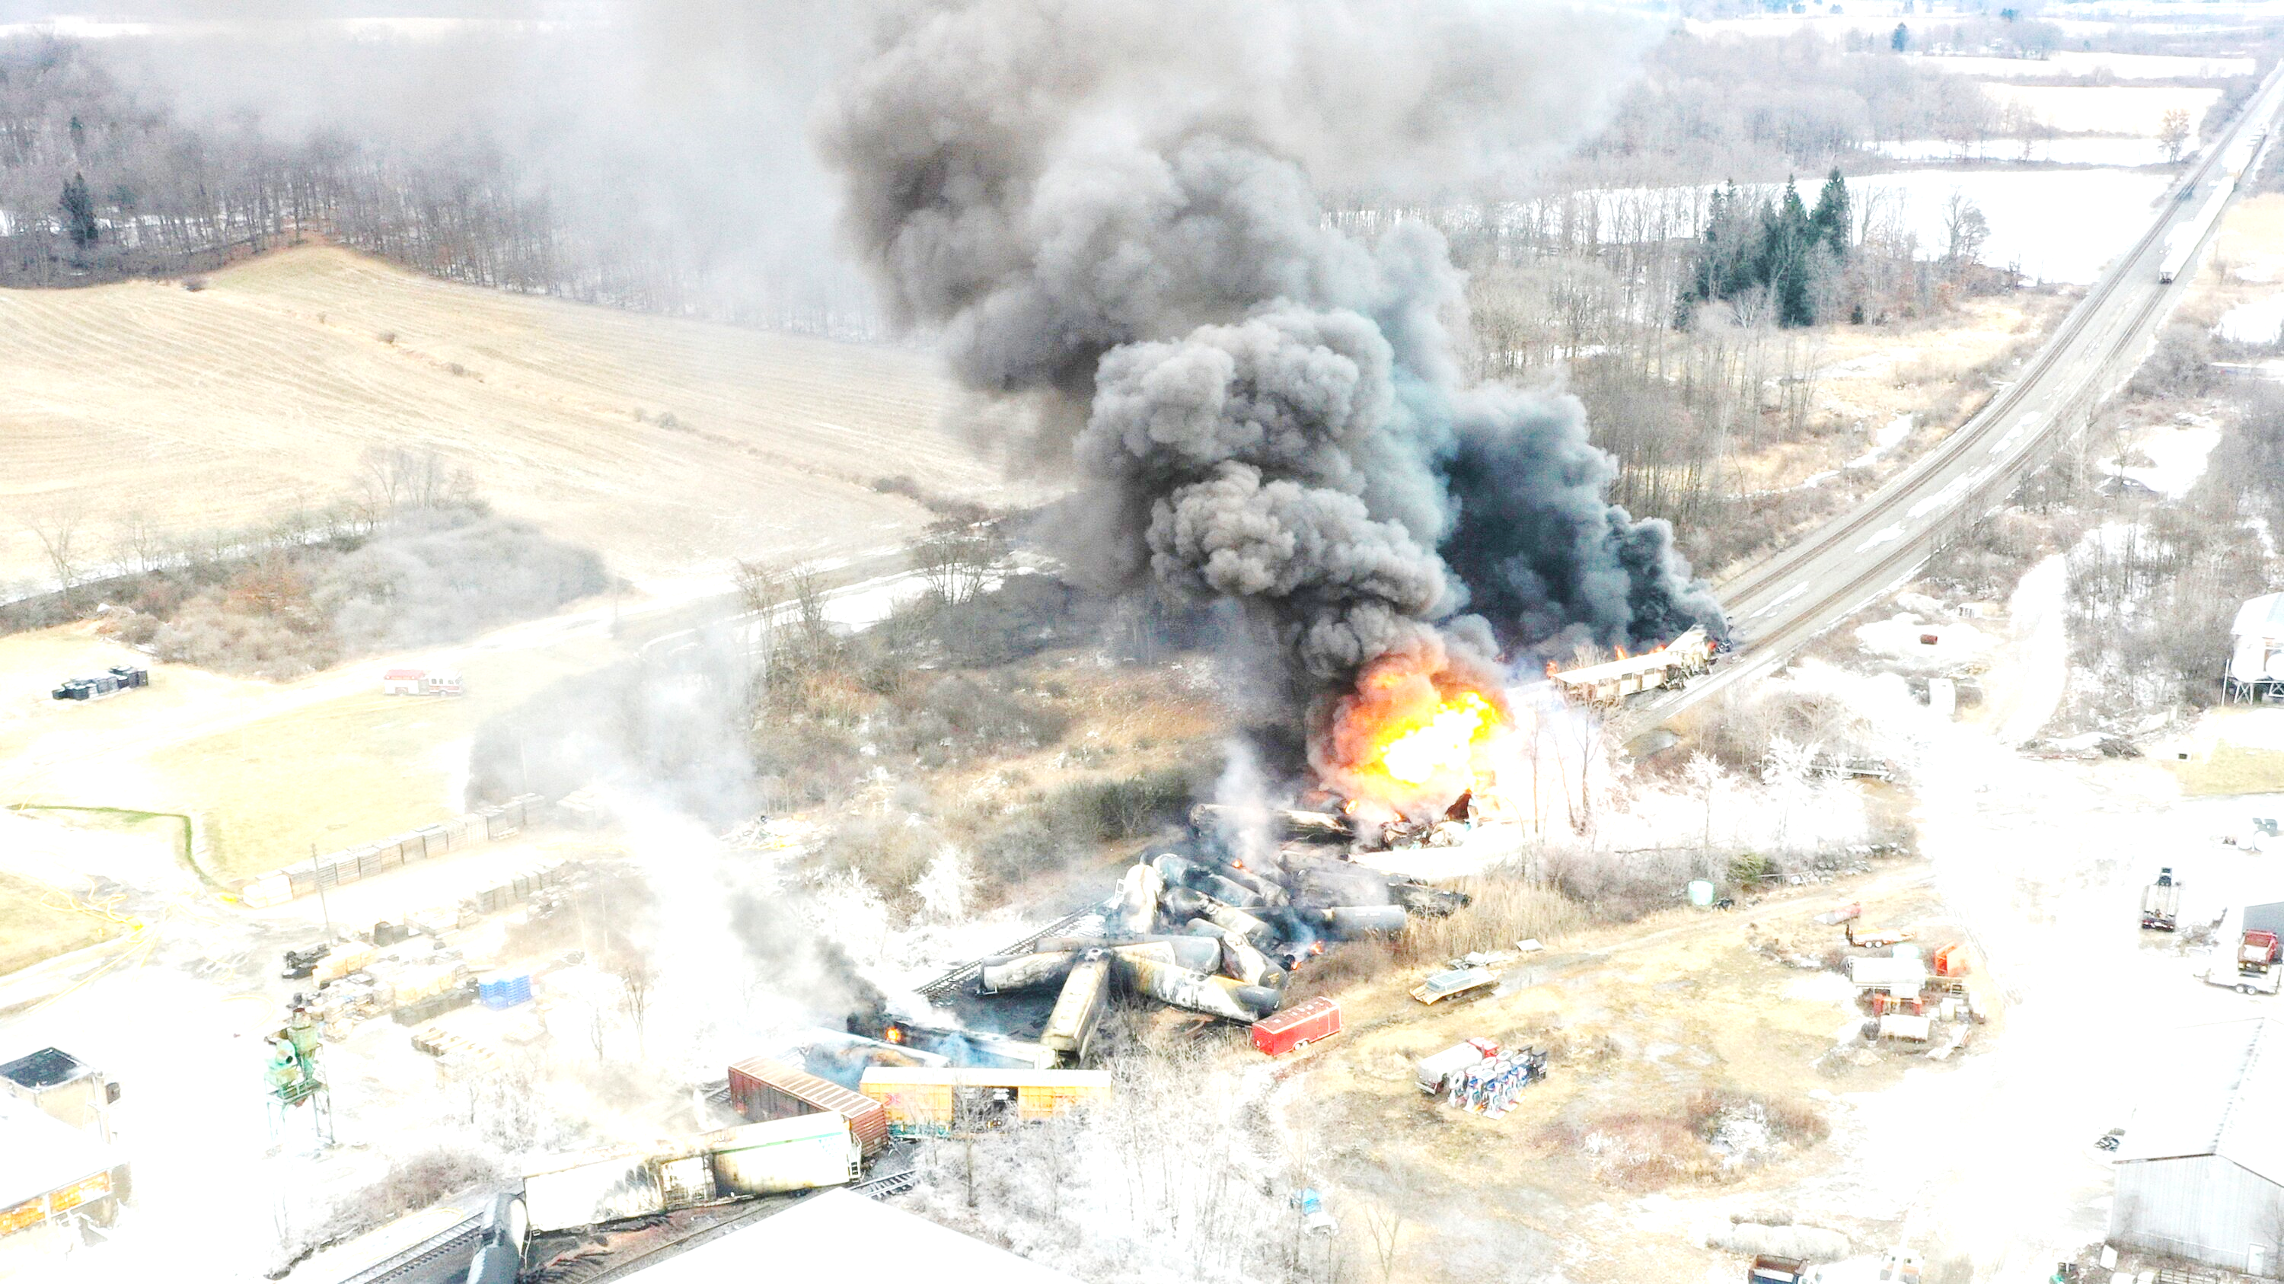
When did you hear about the disaster?
Was the information spread Delayed for nearby residents?
Notes:
However, have you heard about this disaster? And have you ever wondered how long it takes for information of the disaster to reach those who are directly impacted?

Slide 4
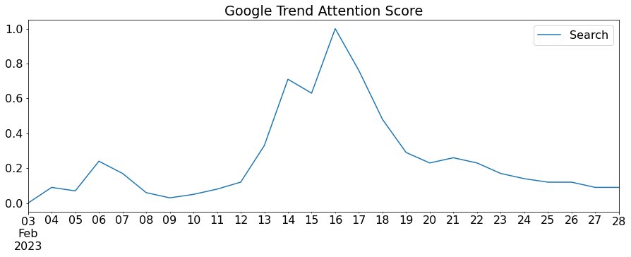
When did you hear about the disaster?
Fig 1. Google Trends Attention Score
About 10 days late
Notes:
In fact, even though it was a severe event, it did not receive much attention from the public 10 days after the incident happened, which raised our concerns about the timeliness of public attention for disastrous events.

Slide 5
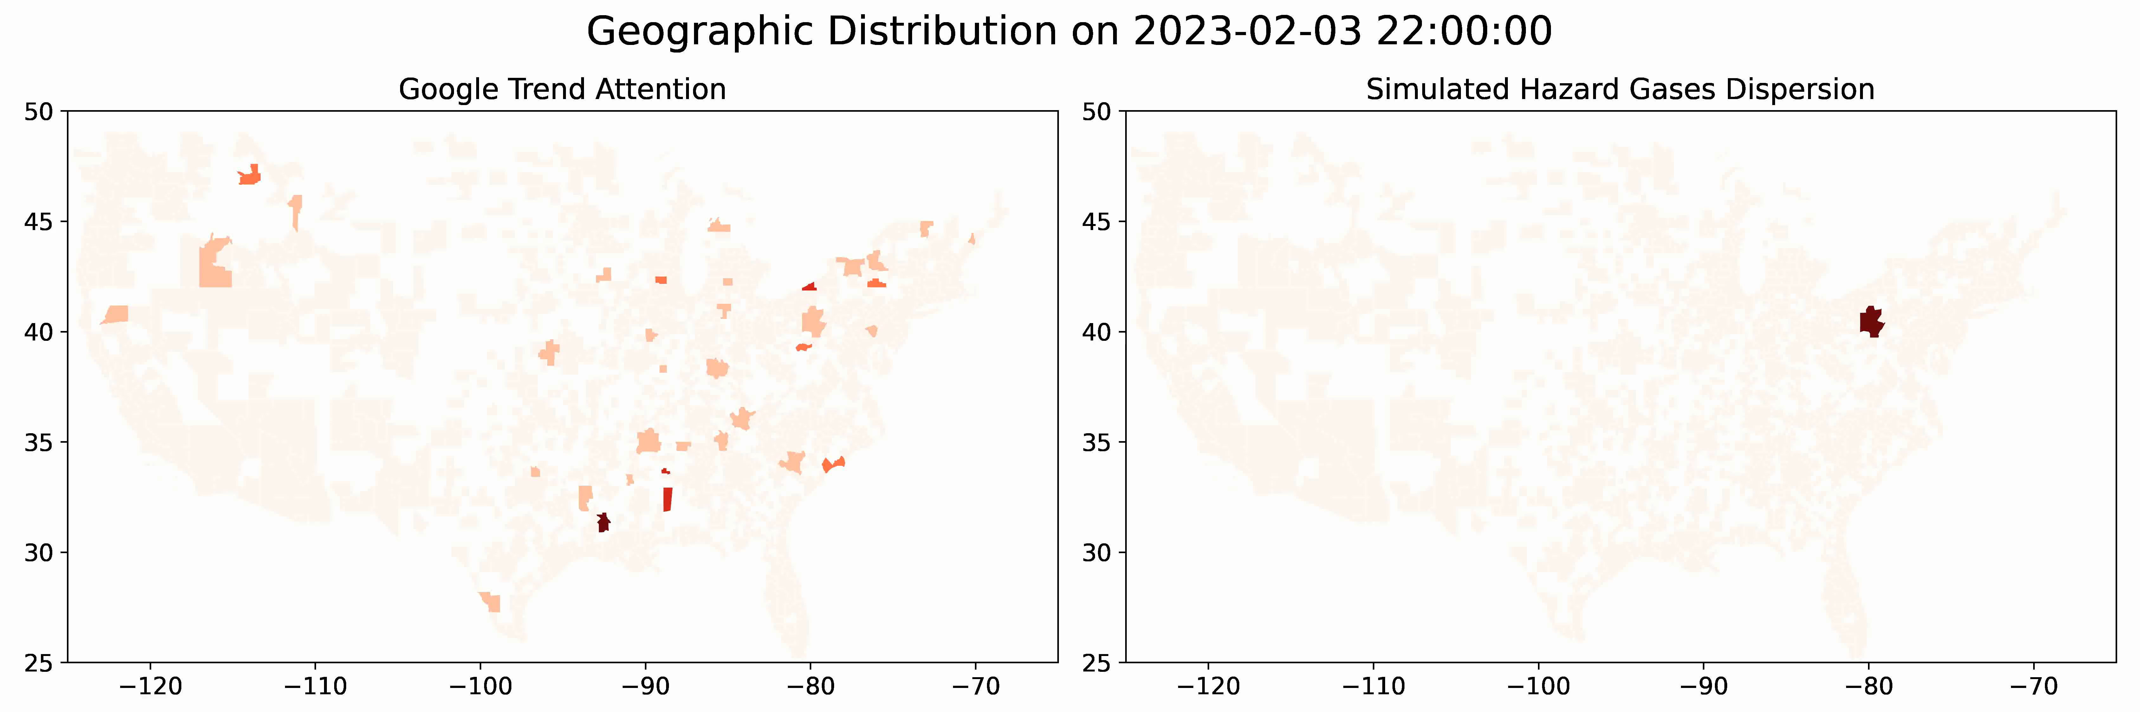
Q1
Were residents of high-risk areas adequately informed about the disaster?
Google Earth Hourly Wind data
Lagrange Dispersion Model Simulation
Gas dispersion ceased prior to February 14th, shortly after the initial surge of public attention
Poor relationship between hazard level and public attention
Comparison of simulated gas distribution with attention on Google
Fig 2. Methodology
Notes:
(Intro of methods)
With this in mind, our study aims to explore the effectiveness of social media in disaster communication and discuss how it can help bridge the gap between disaster occurrence and response.
As the first phase of our methodology framework, we simulated the hazard's geographical distribution to estimate its impact and attention from nearby areas by Using a 2D Lagrangian Dispersion model and wind data from Google Earth Engine, Results reveal a discrepancy between the daily geographic distribution of the simulated hazard and actual attention trend, indicating a lack of awareness in high-risk areas.

Slide 6
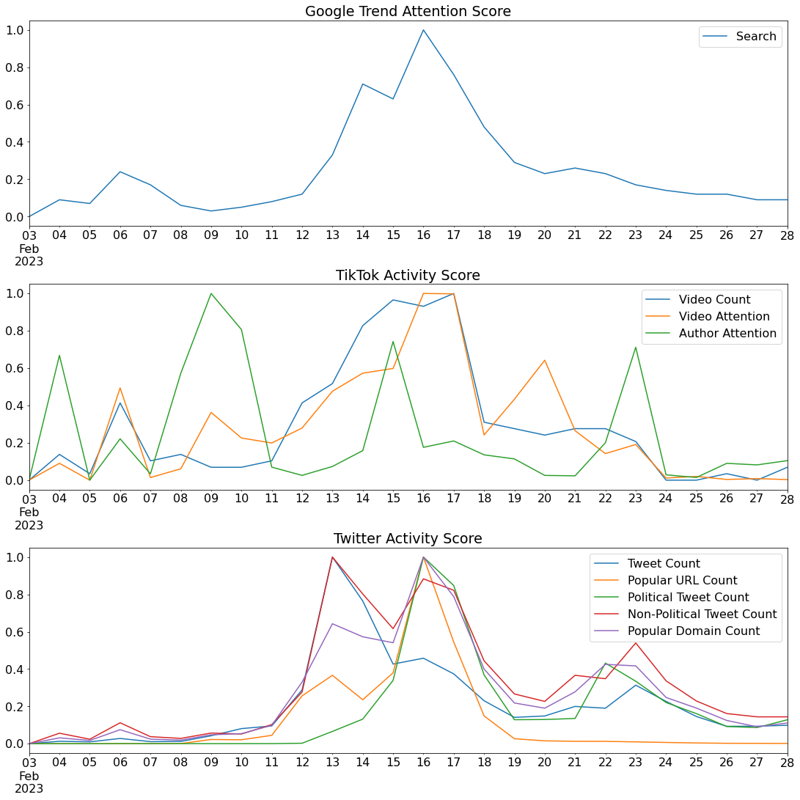
Q2
When does public attention begin?
Our finding shows that each social media platforms has its own peak of interest over time.
TikTok videos are very timely but not impactful
Tweets and news are influential, especially for political ones, but lagged
Fig 3. Social Media Time Series Features
Notes:
(Methods intro and Early peaks shows tiktok videos are timely, but it doesn’t affect the attention too much but it’s different for tweets and popular news)
This motivates further exploration of the crucial factors that attract people's attention towards disasters. We analyzed the popularity of disaster-related content on social media platforms like TikTok and Twitter, and Google Trends using time series analysis. We found that TikTok videos, especially political ones, quickly reported the incident but received less attention, while Tweets and news had a delayed impact. Additionally, Google Trends showed that searches peaked later.

Slide 7
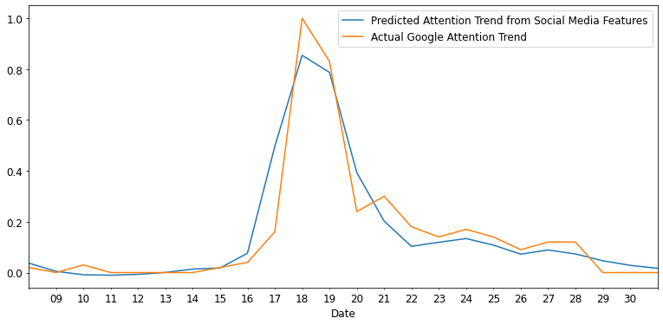
Q3
How does social media activity relate to Google search behavior?
Social media is good at
capturing attention
However, it should be
more effective and timely
Fig 4. Social Media Predicting Attention Trend
in Minnesota Nuclear Leak Accident
Notes:
(Minnesota nuclear leak accident further support our study, so we come to the conclusion)
Given the delayed search behavior on Google, we investigated the link between social media activity and search behavior during a disaster. By training a GRU model on social media data, we found that it can effectively predict search volume on Google, as evaluated in the Minnesota nuclear leak incident.

Slide 8
Methodology Recap
Simulated the dispersion of hazardous gas after the derailment incident
Identified geographic distribution of high-risk areas
Analyzed popularity statistics of “Derailment” related TikTok videos
Compared social media popularity with daily Google Trends for “Derailment”
Trained a GRU model to predict attention trend in Minnesota nuclear leak accident for feature evaluation
Collected “Derailment” related Twitter data (tweets, URLs and news) for popularity analysis
Notes:
(recap our methodology)
To recap our methodology, we first conducted a simulation on the dispersion of hazardous materials and found that people living in high-risk areas had low levels of awareness during the dispersion. Later, we collected data from social media platforms such as TikTok, Twitter, and news outlets that included the word "derailment" from February 3rd to the end of the month for popularity and trend analysis. We then compared the time series pattern with Google trends for the same period using the word "derailment" and discovered that social media, especially TikTok, was leading the discussion. Finally, we trained a GRU time series model to predict the awareness level of another disastrous event using social media features.

Slide 9






Why is our study important?
Reinforced timely attention
Show care for those affected,
like the East Palestine community
Examined social media’s
performance in disasters
Help set up informative
communication channels
Proposed a method based
on disaster simulation
and trend distribution
Effectively estimate
people’s awareness of risk
Notes:
(Significance)
So why our research so important?
First, we stress the significance of timely public attention during disasters, and we encourage the society to care more for those threatened by disasters, such as the East Pastine residents.
Secondly, by examining social media’s performance in the disaster, we can have a deep understanding of their characteristics, so that we can set up more informative communication channels.
Given how influential social medias are, we can use them to alert and notify people of such disasters as soon as possible, which is especially crucial for nearby residents.
Thirdly, by proposed a method of comparing geographic distribution of simulated risk and actual attention trend, we can effectively estimate people's risk awareness.
These information can play a very important role in disaster management. For example, we can use them to identifying high-risk areas with higher accuracy and tailor more effective disaster response.

Slide 10
Thank You
Notes:
Thank you for supporting our research, we hope it can help the East Pastine Community and anyone affected by such disasters.

